Slide 1
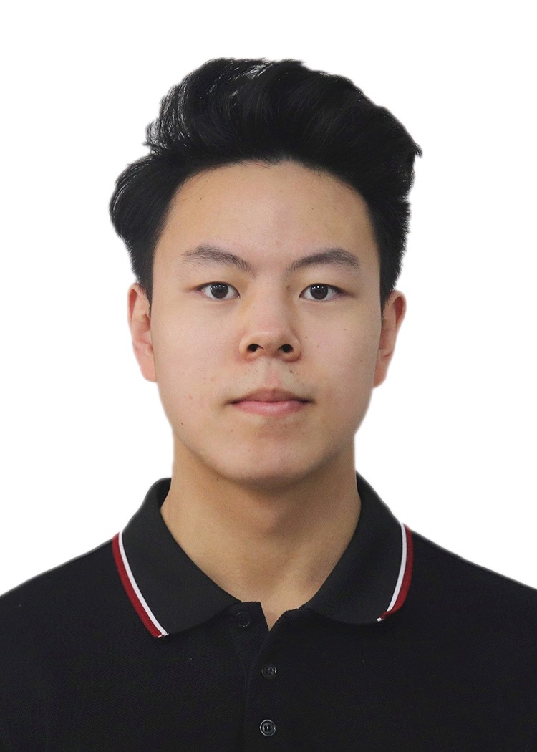
Automata-Based Trace Analysis for Aiding Diagnosing GUI Testing Tools for Android
Enze Ma, Shan Huang, Weigang He, Ting Su, Jue Wang,
Huiyu Liu, Geguang Pu, Zhendong Su
ESEC/FSE 2023
San Francisco, United States
Notes:
I think im the last one to present today, so hopefully I can make it engaging. Hello everyone , im enze ma from east china normal univesity. First of all thanks for your time and attention. Today i'll introduce our work, Automata-Based Trace Analysis for Aiding Diagnosing GUI Testing Tools for Android

Slide 2
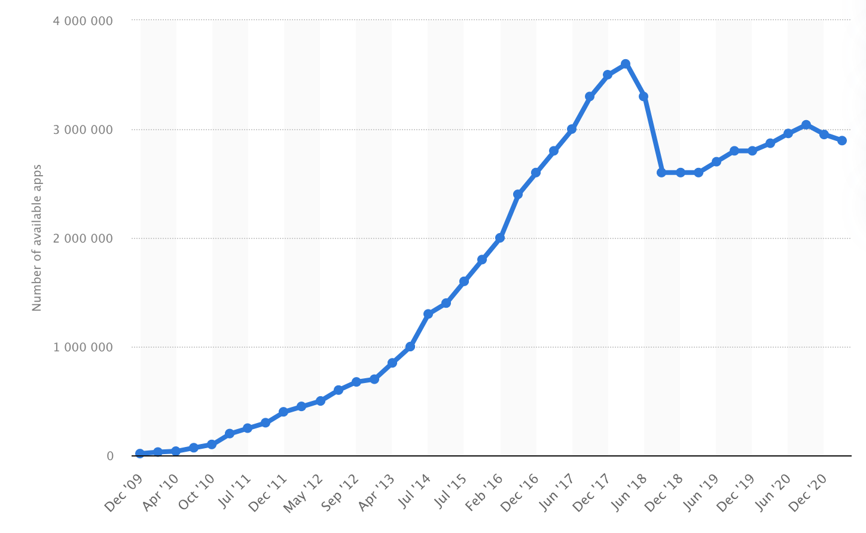
Mobile Apps are Ubiquitous
Notes:
Android app are ubiquitous. As we can see, millions of apps have been developed on the market for daily use.

Slide 3
Ensuring App Quality by Automated GUI Testing
Tool | Source | Strategy | Release Year
Monkey | Google | Random | 2008
Stoat | ESEC/FSE | Model-based | 2016
DroidBot | ICSE | Model-based | 2017
APE | ICSE | Model-based | 2019
Humanoid | ASE | Deep Learning-based | 2019
Q-testing | ISSTA | Reinforcement learning-based | 2020
ComboDroid | ICSE | Model-based | 2020
WCTester | Wechat | Random & Reinforcement learning-based | 2021
Fastbot | ByteDance | Model- & Reinforcement learning-based | 2021
Notes:
So ensuring app quality is very important and automated GUI testing is a popular solution. The last decade witnessed a proliferation of automated testing tools to help find crash bugs in the apps

Slide 4
GUI Testing Tools May Miss Bugs
Themis^{[1]} benchmark has found that individual tools missed a large portion (53.8∼71.2%) of critical bugs.
 | Monkey | APE | Humanoid | ComboDroid | TimeMachine | Q-Testing | Stoat
#Found Bugs | 22 | 24 | 18 | 21 | 15 | 10 | 19
#Missed Bugs | 30 | 28 | 34 | 31 | 37 | 42 | 33
【1】Benchmarking automated GUI testing for Android against real-world bugs. Ting Su, Jue Wang, and Zhendong Su. 2021. ESEC/FSE 21. 119–130.
Notes:
A recent study called themis benchmarked several testing tools against a set of representative, ground-truth app bugs, and it found that individual tools missed a large portion (53.8∼71.2%) of critical bugs.

Slide 5
An Example Bug: ScarletNotes-#114
No Notes
It seems you have not added any notes. Click to add a note.
c1
l0
S0
Github Issue Link: [BUG] Crash on Locked notes screen · Issue #114 · BijoySingh/Scarlet-Notes (github.com)
Notes:
So here we show an example of a crash bug of scarlet notes, an app used to take notes and to-do lists. We present the minimal bug-triggering trace, which includes five pivot clicking events (steps). First clicking the notebook creation button to create a notebook

Slide 6
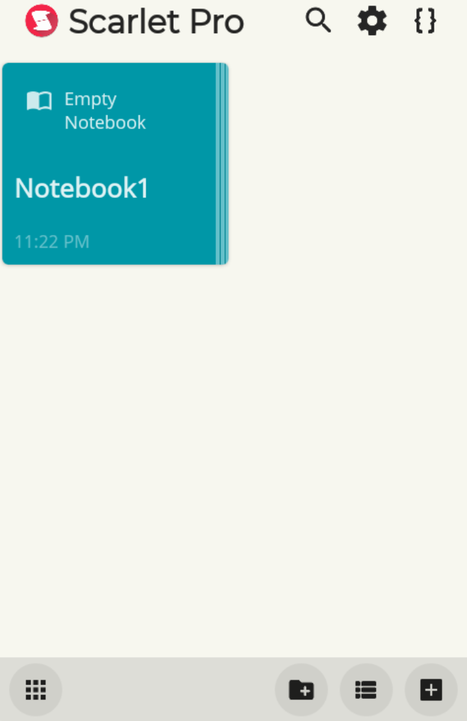
An Example Bug: ScarletNotes-#114
No Notes
c2
It seems you have not added any notes. Click to add a note.
c1
l0
S0
S1
Github Issue Link: [BUG] Crash on Locked notes screen · Issue #114 · BijoySingh/Scarlet-Notes (github.com)
Notes:
Then we click the created notebook “Notebook1” on page 𝑙1 to enter into its directory

Slide 7
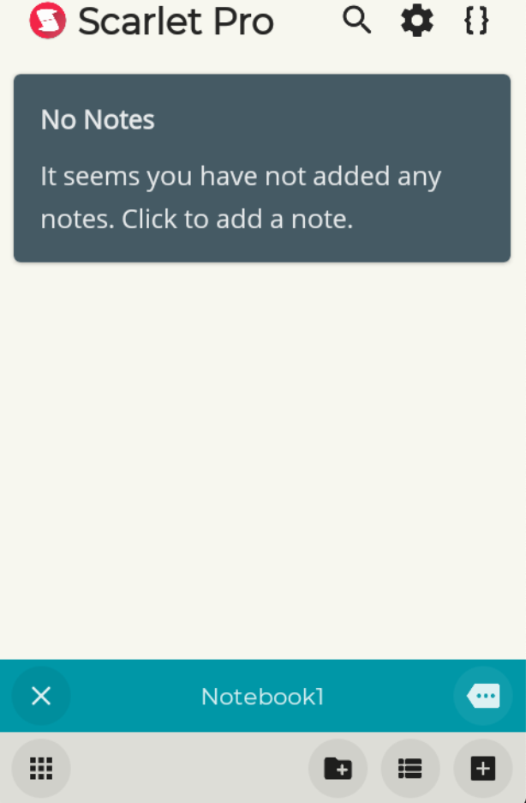
An Example Bug: ScarletNotes-#114
No Notes
No Notes
It seems you have not added any notes. Click to add a note.
c2
It seems you have not added any notes. Click to add a note.
c1
Notebook1
c3
l0
l2
S0
S1
S2
Github Issue Link: [BUG] Crash on Locked notes screen · Issue #114 · BijoySingh/Scarlet-Notes (github.com)
Notes:
and then open the menu by clicking the menu button

Slide 8
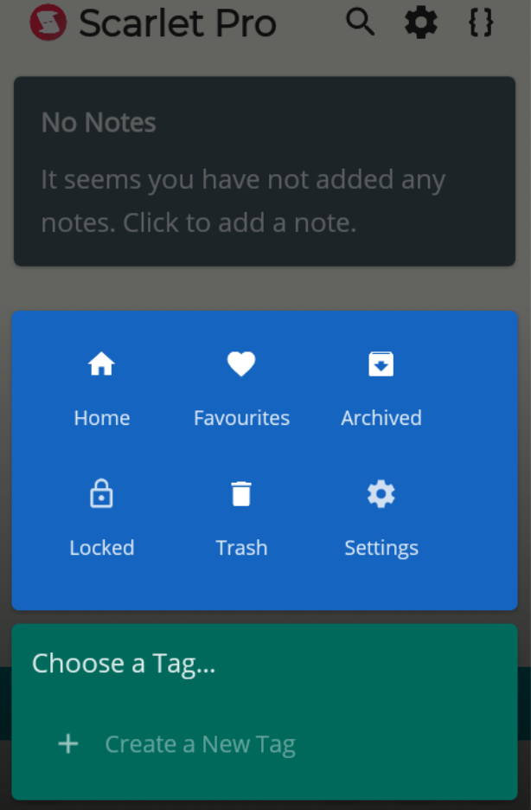
An Example Bug: ScarletNotes-#114
No Notes
No Notes
It seems you have not added any notes. Click to add a note.
c2
It seems you have not added any notes. Click to add a note.
Home
Favorites
Archived
c4
Locked
Trash
Settings
c1
Notebook1
c3
l0
l2
l3
S0
S1
S2
S3
Github Issue Link: [BUG] Crash on Locked notes screen · Issue #114 · BijoySingh/Scarlet-Notes (github.com)
Notes:
choosing the “Locked” option on the menu to show the locked notes (page 𝑙3)

Slide 9
An Example Bug: ScarletNotes-#114
No Notes
No Notes
No Notes
It seems you have not added any notes. Click to add a note.
c2
It seems you have not added any notes. Click to add a note.
It seems you have not added any notes. Click to add a note.
Home
Favorites
Archived
c4
Locked
Trash
Settings
c5
c1
Notebook1
Notebook1
c3
l0
l2
l3
l4
S0
S1
S2
S3
S4
Github Issue Link: [BUG] Crash on Locked notes screen · Issue #114 · BijoySingh/Scarlet-Notes (github.com)
Notes:
Finally clicking the “exit” button on page 𝑙4 to exit from “Notebook1,

Slide 10
An Example Bug: ScarletNotes-#114
No Notes
No Notes
No Notes
No Notes
It seems you have not added any notes. Click to add a note.
c2
It seems you have not added any notes. Click to add a note.
It seems you have not added any notes. Click to add a note.
It seems you have not added any notes. Click to add a note.
Scarlet Notes has stopped
×
Close app
Home
Favorites
Archived
c4
Locked
Trash
Settings
c5
c1
Notebook1
Notebook1
Notebook1
c3
l0
l2
l3
l4
l5
S0
S1
S2
S3
S4
S5
Github Issue Link: [BUG] Crash on Locked notes screen · Issue #114 · BijoySingh/Scarlet-Notes (github.com)
Notes:
and the app crashes. The bug-triggering condition of this issue is filtering the locked notes under some notebook’s directory (no matter where to exit)

Slide 11
An Example Bug: ScarletNotes-#114
No Notes
No Notes
No Notes
No Notes
It seems you have not added any notes. Click to add a note.
c2
It seems you have not added any notes. Click to add a note.
It seems you have not added any notes. Click to add a note.
It seems you have not added any notes. Click to add a note.
Scarlet Notes has stopped
×
Close app
Home
Favorites
Archived
c4
Locked
Trash
Settings
c5
c1
Notebook1
Notebook1
Notebook1
c3
l0
l2
l3
l4
l5
S0
S1
S2
S3
S4
S5
c1
c2
c3
c4
……
c4
c5
c3
c4
……
……
A Length Event Trace:
c2
c3
c3
c4
……
c2
Github Issue Link: [BUG] Crash on Locked notes screen · Issue #114 · BijoySingh/Scarlet-Notes (github.com)
Notes:
We applied all the state-of-the-art automated gui testing tools for android to have a try on this bug, they all generated a very long sequence of ui events. !!!!!However the results showed that all the tools fail to find this bug.
Note!!!!! bug-triggering condition of this issue is filtering the locked notes under some notebook’s directory (no matter where to exit)

Slide 12
Why Do These Tools Miss This Bug?
Notes:
Then surely a very natural question goes Why Do These Tools Miss This Bug? Currently, developers can only get the knowledge whether their tool can find a bug or not, They don’t really know why the tool misses a bug.

Slide 13
Key Challenge
Manually debugging GUI tools against the missed bugs to find some clues is difficult and time-consuming.
The key challenge is: How to automatically and effectively analyze the lengthy event traces generated by a tool against a missed bug to find the clues ?
Notes:
Developers find it hard and time-consuming to manually debug their tools against the missed bugs to find some clues. So The key problem in our setting is that How to automatically and effectively analyze the lengthy event traces generated by a tool against a missed bug to find the clues？

Slide 14
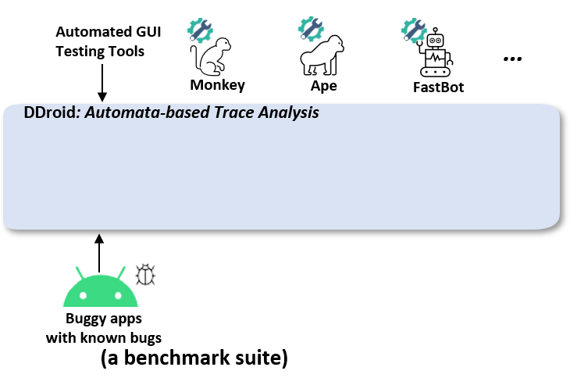
Our Approach: Automata-Based Trace Analysis
Notes:
To tackle this challenge we proposed a automata-based trace analysis approach . Firstly we gather reproducible bugs from a benchmark suite like themis and apply tools to to run against these bugs.

Slide 15
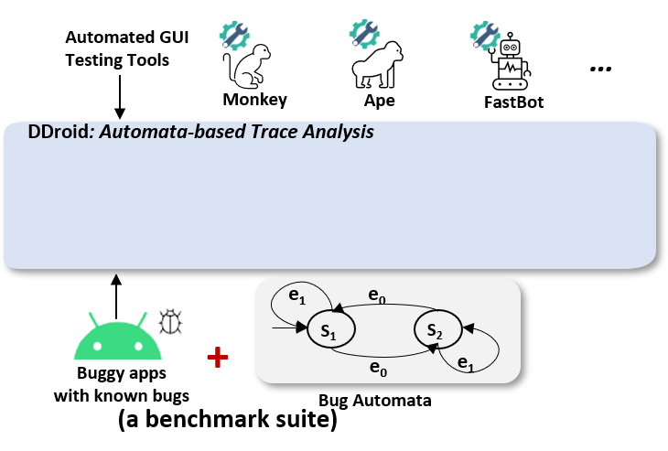
Our Approach: Automata-Based Trace Analysis
Notes:
The main idea is that , we model a bug in the form of an nondeterministic finite automaton (named as the bug automaton), which captures its bug triggering traces. In this way, we can automatically match the event trace generated by the testing tool (which misses this bug) against this automaton to monitor tool behaviors

Slide 16
Bug automaton
No Notes
It seems you have not added any notes. Click to add a note.
c1
S0
s₀
Step1: Initializing the automaton
Notes:
Now we go back to the example.to elaborate the build of automaton .we first Initialize the automaton by the minimal bug triggering trace,

Slide 17
Bug automaton
No Notes
c2
It seems you have not added any notes. Click to add a note.
c1
S0
S1
s₁
c₁
s₀
Step1: Initializing the automaton
Notes:
in this case we have 5 pivot events, like c1,c2

Slide 18
Bug automaton
No Notes
No Notes
It seems you have not added any notes. Click to add a note.
c2
It seems you have not added any notes. Click to add a note.
c1
Notebook1
c3
S0
S1
S2
s₁
c₁
s₀
c₂
s₂
Step1: Initializing the automaton
Notes:
in this case we have 5 pivot events, like c1,c2,c3

Slide 19
Bug automaton
No Notes
No Notes
No Notes
No Notes
It seems you have not added any notes. Click to add a note.
c2
It seems you have not added any notes. Click to add a note.
It seems you have not added any notes. Click to add a note.
It seems you have not added any notes. Click to add a note.
Scarlet Notes has stopped
Home
×
Close app
Favorites
Archived
c4
Locked
Trash
Settings
c5
c1
Notebook1
Notebook1
Notebook1
c3
S0
S1
S2
S3
S4
S5
s₁
s₄
c₅
s₅
c₄
c₁
s₀
c₂
s₂
s₃
c₃
Step1: Initializing the automaton
Notes:
Followd by c4 and c5

Slide 20
Bug automaton
No Notes
No Notes
No Notes
No Notes
It seems you have not added any notes. Click to add a note.
c2
It seems you have not added any notes. Click to add a note.
It seems you have not added any notes. Click to add a note.
It seems you have not added any notes. Click to add a note.
Scarlet Notes has stopped
Home
×
Close app
Favorites
Archived
c4
Locked
Trash
Settings
c5
c1
c1
c1
Notebook1
Notebook1
Notebook1
c3
S0
S1
S2
S3
S4
S5
c₁
s₁
s₄
c₅
s₅
c₁
c₄
c₁
s₀
c₂
s₂
s₃
c₃
Step 2: Adding pivot-event transitions
Notes:
After Step 1, the automaton only captures the minimal bug-triggering trace. To capture those non-minimal bug-triggering traces, we need to include other transitions enabled by the pivot events into the automaton. for example 𝑠tate1 can take 𝑐1 to reach 𝑠1 itself,

Slide 21
Bug automaton
No Notes
No Notes
No Notes
No Notes
It seems you have not added any notes. Click to add a note.
c2
It seems you have not added any notes. Click to add a note.
It seems you have not added any notes. Click to add a note.
It seems you have not added any notes. Click to add a note.
Scarlet Notes has stopped
Home
×
Close app
Favorites
Archived
c4
c5
Locked
Trash
Settings
c5
c1
c1
c1
c1
Notebook1
Notebook1
Notebook1
c3
c3
S0
S1
S2
S3
S4
S5
c₁
c₁ / c₃
s₁
s₄
c₅
s₅
c₅
c₁
c₄
c₁
s₀
c₂
s₂
s₃
c₃
Step 2: Adding pivot-event transitions
Notes:
S2 can take c5 to reach s1,etc.And we enumerate this process by checking whether any pivot events can be executed on each state

Slide 22
Bug automaton
back
back
back
No Notes
No Notes
No Notes
No Notes
It seems you have not added any notes. Click to add a note.
c2
It seems you have not added any notes. Click to add a note.
It seems you have not added any notes. Click to add a note.
It seems you have not added any notes. Click to add a note.
Scarlet Notes has stopped
Home
×
Close app
Favorites
Archived
c4
c5
Locked
Trash
Settings
c5
c1
c1
c1
c1
Notebook1
Notebook1
Notebook1
c3
c3
S0
S1
S2
S3
S4
S5
c₁
c₁ / c₃
c₄
ε
c₅
s₆
s₁
s₄
s₅
/ ε
c₃
c₅
c₁
c₄
c₁
ε
s₀
c₂
s₂
s₃
c₃
Step 3: Adding ε-transitions (the final automaton)
Notes:
And finally, we add the 𝜖-transitions to capture new non-minimal bug-triggering traces. For example one can press Back on s2,s3,s4 to jump back to s1,s2,s1, respectively. After the construction, we automatically convert the bug automaton in the form of 𝜖-NFA to its equivalent deterministic finite automaton (DFA) by eliminating the 𝜖 transitions

Slide 23
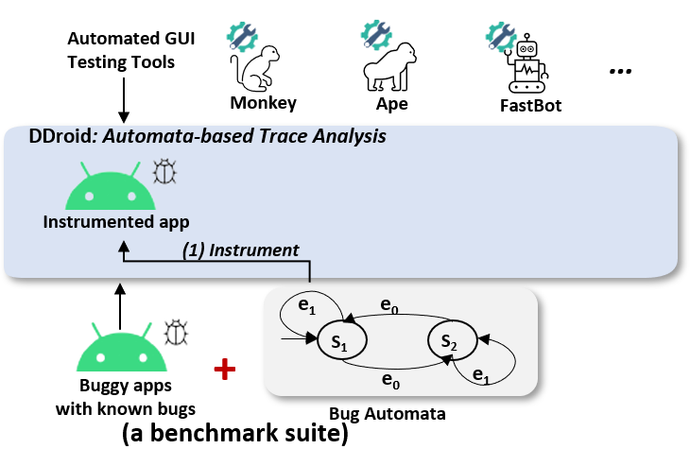
Our Approach: Automata-Based Trace Analysis
Notes:
After building the bug automaton, We use ASM and Gradle Transformer to automatically instrument apps at the event handlers to uniquely log executed UI events

Slide 24
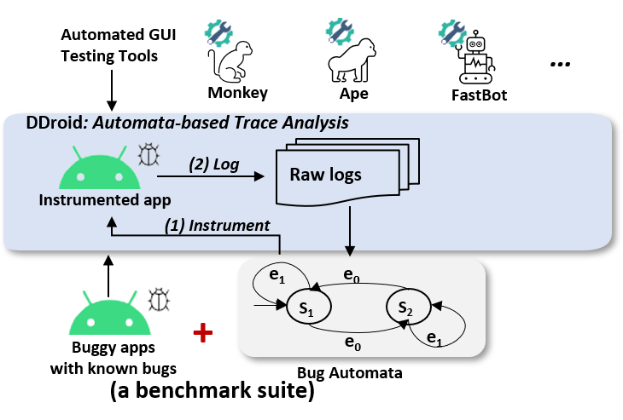
Our Approach: Automata-Based Trace Analysis
Notes:
Then we let testing tools run against the instrumented app to log the executed pivot events to form an event trace

Slide 25
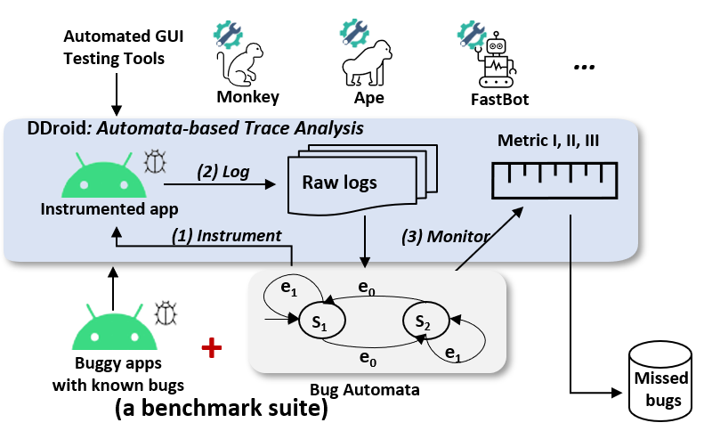
Our Approach: Automata-Based Trace Analysis
Notes:
Finally, we match the logged event trace against our dfa and compute the coverage metrics

Slide 26
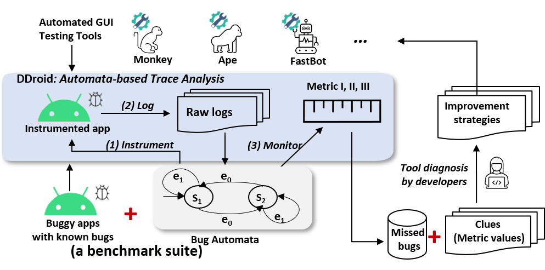
Our Approach: Automata-Based Trace Analysis
Themis⁺
Themis
Notes:
Accroding to the clues we provided developers can Make improvments on the tools
To this end, we named our approach as DDRoid and the enhanced benchmark suite as themis+

Slide 27
Coverage Metric Based Clues
Statement Coverage
Event Coverage (EC)
Event-Pair Coverage (EPC)
Trace-based Minimal Distance (MD)
Branch Coverage
Path Coverage
c₁
c₁ / c₃
c₄
ε
c₅
s₆
s₁
s₄
s₅
/ ε
c₃
c₅
c₁
c₄
c₁
ε
s₀
c₂
s₂
s₃
c₃
Notes:
The clues are provided as three metrics: event coverage, event-pair coverage and traces-based minimal distance, and every metrics supplements each other.
to make an analogy, EC is similar to the statement coverage in classic software testing to denote the covered events.
EPC is similar to the branch coverage. And is a stronger metric than EC. It can assess the ability of a testing tool Γ to execute two adjacent transitions.
And md can assess whether a testing Γ can exercise the events of the bug-triggering trace in some specific orders, and quantify how far the tool is to reach final state in terms of number of events to be executed

Slide 28
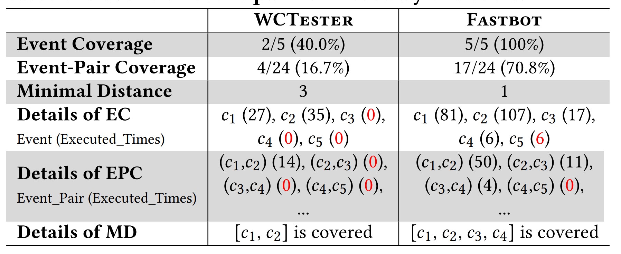
Example Clues: Scarlet-Notes #114
Notes:
In the previous example of scarlet notes, we illustrate 2 tools metrics data.:
From the metrics we can see that Wctester could not cover all events and fastbot could not execute c5 right after c4, so they both failed to find the bugs.

Slide 29
Evaluation
Instrumented 47 critical bugs from themis dataset ;
Selected 9 state-of-the-art tools from academic and industrial fields
Labeled as “high-priority”, “blocking release”, “P1-urgent”, etc;
Deterministically reproducible with one GUI-level test.
Notes:
So for the themis+ dataset, we incoportate 47 instrumented bugs that are reproducible and critical

Slide 30
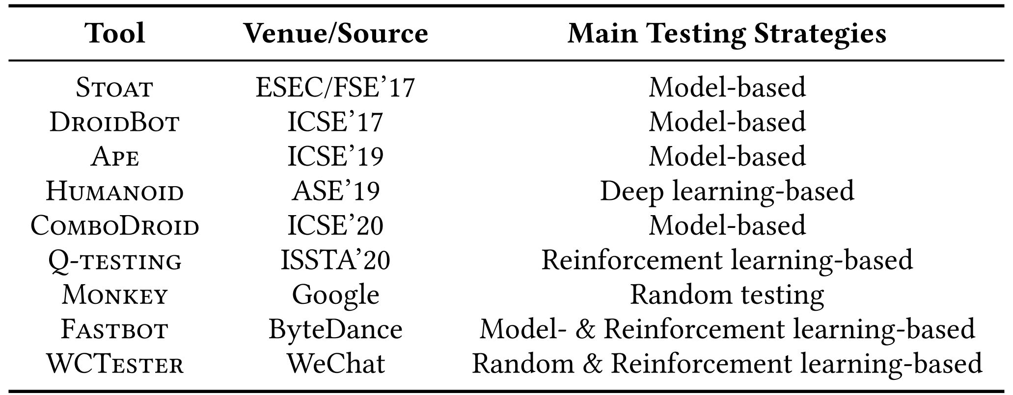
Selected Tools for Themis⁺
Nine state-of-the-art/practice GUI testing tools with different techniques
Also the two well-known industrial tools, WCTester and Fastbot
Notes:
and we choose 9 state-of-the-art tools from academic and industrial fields

Slide 31
Research Questions
RQ1: Can Themis⁺ provide the clues on the bugs missed by automated GUI testing tools, compared to Themis?
Notes:
We try to answer two research questions. (give details of these questions)
The first one is :Can Themis⁺ provide the clues on the bugs missed by automated GUI testing tools, compared to Themis?

Slide 32
Evaluation Setup for RQ1
Run each bug/tool for 6 hours and repeat 5 times
Run all the apps on Android emulators 7.1
Total time cost: 47*6*5*9=12690 CPU hours
Notes:
To setup for rq1, we need to benchmark these GUI testing tools against the bugs, we run each bug per tool for 6 hours and repeat 5 times to metigate the randomness. The total testing time is over 10 thousand CPU hours.

Slide 33
RQ1: Results
Bugs | Monkey |  |  | WCTester |  |  | Fastbot |  |  | …
 | EC | EPC | MD | EC | EPC | MD | EC | EPC | MD | …
AD-#118 | 50 | 47 | 7 | 50 | 43 | 7 | 50 | 43 | 7 | …
Anki-#4200 | 75 | 33 | 3 | 100 | 100 | 0 | 100 | 100 | 0 | …
GHD-#73 | 100 | 100 | 0 | 100 | 100 | 0 | 100 | 100 | 0 | …
SN-#114 | 20 | 5 | 5 | 40 | 17 | 3 | 100 | 71 | 1 | …
NC-#4792 | 60 | 46 | 2 | 100 | 73 | 2 | 100 | 82 | 2 | …
… | … | … | … | … | … | … | … | … | … | …
Detailed clue metrics
Notes:
With the help of our approach, Themis+ can provide more detailed clues on the missed bugs, which is shown on the three metrics data, and they cannot be obtained by Themis. We focus on these achieved best values as they indicate the best tool performance from the 5 rounds
Take the results of WCTester on bug “SN-114” as an example the best achieved EC, EPC, MD among the five testing runs are 40%, 17% and 3, respectively. From such metric values, we can obtain the clues like which events and event-pairs are missed and how close a tool can reach the bug. The metrics are provided within this table for further analysis.

Slide 34
Research Questions
RQ1: Can Themis⁺ provide the clues on the bugs missed by automated GUI testing tools, compared to Themis?
RQ2: How useful are the clues provided by Themis⁺ for aiding diagnosing GUI testing tools, compared to the manual analysis?
Notes:
And the second research question focuses on How useful are the clues provided by Themis⁺ for aiding diagnosing GUI testing tools, compared to manual analysis

Slide 35
Evaluation Setup for RQ2
DDroid Analysis
Manual Analysis
Notes:
In the second research question, We invited the developers of seven tools to investigate the usefulness of the Themis+ ’s clues by comparing Developers’ manual analysis against DDroid analysis.
we gave the tool developers the missed bugs and let them try their best to manually find the clues based on the buggy app and the bug-triggering traces to build a ground-truth clues. Then we gave the same developers the Themis+ ’s clues to validate its usefulness

Slide 36
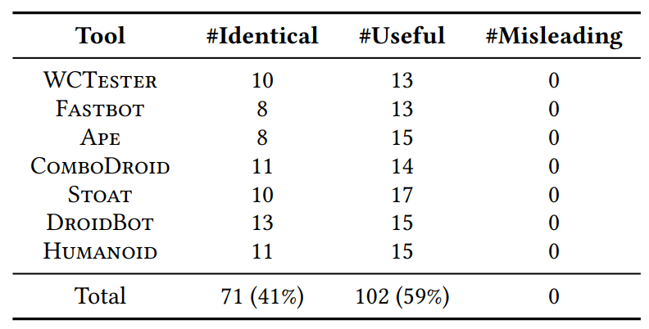
RQ2: Clues’ Usefulness
Validation results of Themis⁺
Finding: All the Themis⁺ ’s clues are identical or useful compared to the clues manually found by developers, without any misleading ones.
Notes:
Thankfully All the Themis⁺ ’s clues are identical or useful compared to the clues manually found by developers, without any misleading ones

Slide 37
RQ2: Clues’ Usefulness
Findings: Existing tools have weaknesses.
Event generation strategy.
A ListView page (simplified from a bug) and its GUI layout
Notes:
Informed by the Themis+ ’s clues, the tool developers have successfully located several tool weaknesses, which were unknown or unclear before. We summarized the weaknesses into three parts event generation
Heres a simplified list view page and a “good” testing tool should generate three click events for “A”, “B” and “C”, respectively. However, some tools generates an event only when a widget’s clickable and enabled properties are both True, while some cannot rewrite the clickable property of a leaf node., thus cannot generate certain events

Slide 38
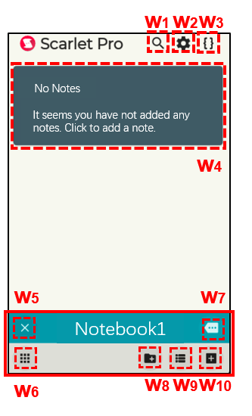
RQ2: Clues’ Usefulness
Findings: Existing tools have weaknesses.
Event generation strategy.
Event selection strategy.
Notes:
There’s also weakness in event selection strategy. In the example app, fastbot assumes widgets w5-w10 on a page have the same widget property values and clusters them into the same widget group to reduce UI exploration space, so that’s why fastbot rarely clicks c5 after c4, thus failing to find the bug

Slide 39
RQ2: Clues’ Usefulness
Findings: Existing tools have weaknesses.
Event generation strategy.
Event selection strategy.
Widget support and Interaction.
Notes:
Other weakness include System keyboard and specific texts generation.
Interaction with external apps.
Supporting specific types of widgets or events

Slide 40
RQ2: Clues’ Usefulness
Optimization: WCTester(Tencent) and Fastbot(ByteDance) .
Notes:
We also make close contact with tool developers. Based on the clues, two actively-developing industrial testing tools have quickly made several optimizations and demonstrated their improved bug finding abilities

Slide 41
RQ2: Clues’ Usefulness
Optimization: WCTester(Tencent) and Fastbot(ByteDance) .
The optimized WCTester and Fastbot found 9 and 6 missed bugs
Finding: WCtester and Fastbot have quickly made several optimizations and demonstrated their improved bug finding abilities.
Notes:
we can see that WCTester and Fastbot have newly found 9 and 6 bugs respectively, and have improved the chance of finding 3 and 4 bugs in terms of the three coverage metrics respectively, which is great leap forward. It is clear that DDroid’s clues have indeed helped improve these two tools.

Slide 42
RQ2: Positive Feedback from Developers
“ I usually use DroidBot’s recorded UI trace graph to debug my tool, but it is very time-consuming for lengthy traces. Themis⁺ ’s clues are exactly what I want.”
--- Droidbot
“Themis⁺ ’s MD metric is very useful. I can quickly know which events or screen pages I should focus on for diagnosing. It can save me a lot of time. ”
--- Ape
“ I routinely improve my testing tool by adding new code. But it is difficult to know how the new tool version works. Themis+ is nice as it can be used as a regression suite. That’s very useful. ”
--- WCTester
“ Due to flakiness, replaying the recorded event trace for debugging is very difficult. I usually cannot find useful clues by manual analysis. Themis⁺ ’s clues helped me a lot. ”
--- Fastbot
Notes:
We displayed several feedbacks from Droidbot ape Wctester and fastbot, and all the tool developers give positive feedback on the usefulness and usability of Themis+ ’s clues.

Slide 43
Summary
An automata-based trace analysis approach by providing the clues on the missed bugs.
Three automata-based coverage metrics to give systematic, fine-grained insights on the potential tool weaknesses.
Found several tool weaknesses and improved two industrial testing tools.
Notes:
So in summary, our work proposed an automata-based trace analysis approach introduced three automata-based coverage metrics as the basis of our clues, which can give systematic fine-grained insights on the potential tool weakness. And our method has made significant improvement on real-world tools

Slide 44
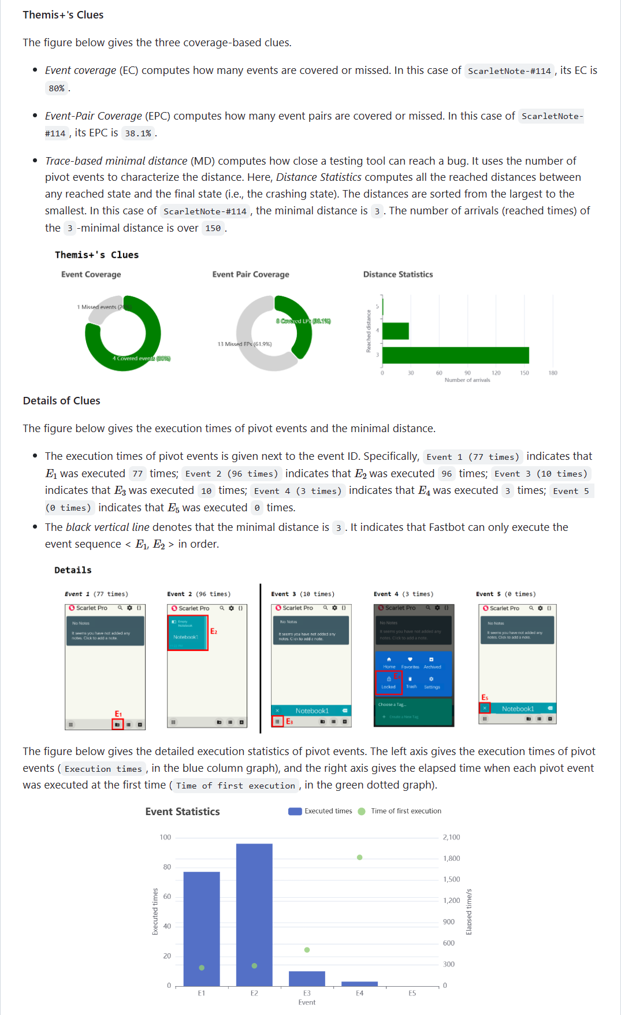
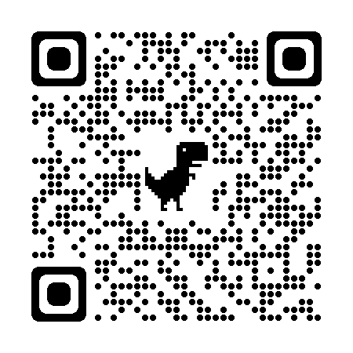
Themis⁺ Benchmark: DDroid-Android/home (github.com)
Tutorial
Bug Dataset
Extensible Infrastructure
Integrated Tools
Active Maintenance
Other research purposes
(fault localization, program repair)
Notes:
We hope our study can inspire more researchers and participants to incorporate our tool into their diagnosis. we have open-sourced our work on github to benefit the community.
Okay, this is the end of my talk. Thank you for your listening. I would like to take any questions.

